Slide 1
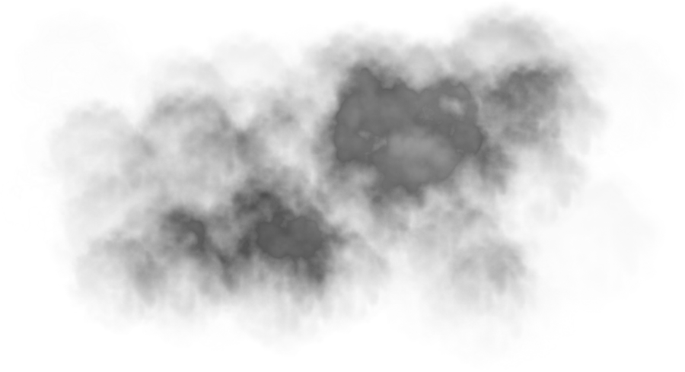







Sean Burke – BSHCE (Hons) in Computing
Statistical analysis on Air pollution
Through different means of analyzing air pollution data the aim of this project is to:
Show that the data is valid by testing the data against a control.
Showcase the difference between air pollution between different surrounding areas.
Is there any correlation between the data from the surrounding areas.
What?
SO₂
PM 2.5
CO₂
PM 10
Technologies used

